Slide 1
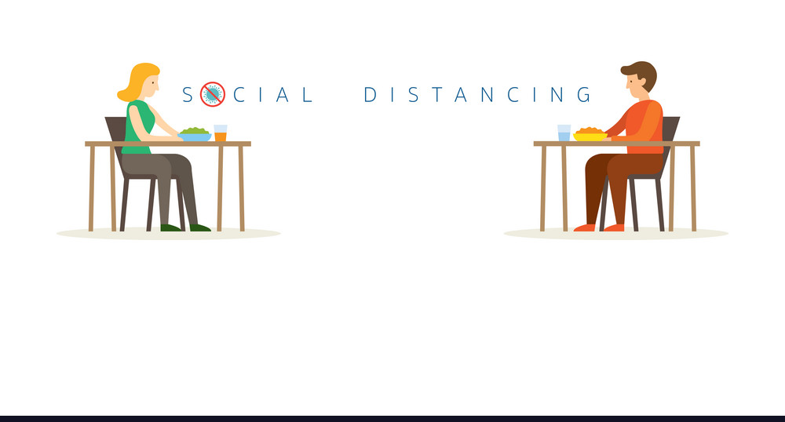

WIT Hackathon - Idea Description

Slide 2



PROBLEM
As per WHO advisory, we need to practice Social distancing to flatten the curve and keep safe from COVID-19. Each firm/institution needs to reassess, reengineer and reimagine their workplace. We can arrange work-desks at a distance to follow social distancing but what about the cafeteria's or public places where managing distancing is really difficult as we can’t compromise employees time and productivity as well as their health and well being.
IDEA
The 'new normal' way to the office cafeteria Efficiently planning social distancing at cafeteria using a web application which will help find the current occupancy of the cafeteria before leaving our desks. This will uphold social distancing by avoiding crowds and help us with live status to avoid hassles of going to the cafeteria to see if it's full/available.
TECHNOLOGY
Using web application, employees need to issue a token to get in the cafeteria. Check in using the web application once entering the cafeteria and check out while exiting. The application admin will keep a track of people in the cafeteria at a time, using check in and check out process and thereby limit the activity of issuing new tokens. Admin can define the maximum tokens that can be issued for a cafeteria based on its size and resource availability. Users can view the number of tokens available at a time and can issue accordingly over web application.

